Slide 1


Department of
Computer Science & Engineering
Voice Agent Studio: A Local, Privacy-First, Quantum-Optimized AI Voice Assistant
Domain: Agentic AI
Amrita School of Computing
Amrita Vishwa Vidyapeetham, Chennai Campus
Student Members [BATCH ID: 2]
1: Mukesh Charan M – CH.SC.U4AIE23032
2: Sanjjey A – CH.SC.U4AIE23050
Guide Details
Dr. Sountharrajan S.
PGP Co-Chair,
Professor,
Dept of CSE

Slide 2

Introduction
Introduction
Literature Survey
Research Gap
Problem Identification
Problem Statement
Motivation
Significance
Objectives
Scope
Evaluation of design
Implementation
Result and Analysis
Gantt Chart
References
• Voice Agent Studio is an ultra-low-latency, privacy-first conversational AI platform engineered to eliminate costly telephony infrastructure and centralized cloud API dependencies.
• Employs an end-to-end local speech pipeline: browser-side Web Audio DSP downsampling (16 kHz PCM), client-side adaptive VAD, Faster-Whisper (small.en) STT, and Piper ONNX neural voice synthesis (en_US-lessac-medium) with Windows SAPI5 fallback for 100% offline speech turnaround.
• Features in-memory BM25 Retrieval-Augmented Generation (RAG) over uploaded enterprise documents (.pdf, .docx, .txt), delivering sub-millisecond context grounding without external vector databases.
• Incorporates hybrid quantum-classical subroutines: IBM Qiskit QAOA / QUBO for combinatorial prompt optimization and PennyLane Variational Quantum Circuits (VQC) for conflict-free multi-booking appointment scheduling.
• Packaged into an isolated on-premises Docker container with zero external data egress, providing enterprise data sovereignty and full compliance with GDPR, HIPAA, and India's DPDP Act 2023.

Slide 3
Literature Survey - Conversational Agents & LLM Security
Introduction
Literature Survey
Research Gap
Problem Identification
Problem Statement
Motivation
Significance
Objectives
Scope
Evaluation of design
Implementation
Result and Analysis
Gantt Chart
References
S.No | Authors & Year | Title | Journal Name | Methods Used | Key Findings | Research Gap Identified
1 | Bhatia & Khetarpaul (2025) | AI-enhanced bilingual banking assistant | Scientific Reports | Multi-turn conversational pipeline with intent classification, LLM response generation, and banking tool execution. | Demonstrated 94.2% task success in bilingual user interactions; improved query completion rates in financial workflows. | Relies entirely on cloud speech services; lacks local edge execution and privacy-preserving offline inference.
2 | Chowa et al. (2026) | LLM agents security duality: a comprehensive survey of self-security and empowered cybersecurity | Artificial Intelligence Review | Survey of autonomous agent vulnerabilities, prompt injection risks, and defensive agent guardrails. | Demonstrates agent susceptibility to adversarial prompts and boundary degradation during tool calling. | No mathematical combinatorial optimization of system prompt guardrails or edge runtime sandboxing.

Slide 4
Literature Survey - Healthcare UX & Full-Duplex Benchmarking
Introduction
Literature Survey
Research Gap
Problem Identification
Problem Statement
Motivation
Significance
Objectives
Scope
Evaluation of design
Implementation
Result and Analysis
Gantt Chart
References
S.No | Authors & Year | Title | Journal Name | Methods Used | Key Findings | Research Gap Identified
3 | Furtado et al. (2025) | Assessing the User Experience of an LLM-based Conversational Agent for Older Adults | Journal of Healthcare Informatics Research | Mixed-method UX evaluation of voice assistants in senior care with speech-driven dialogue. | High user acceptance when latency is <1000ms; voice naturalness directly correlates with user trust. | High reliance on commercial cloud APIs introduces significant latency variance and cost bottlenecks.
4 | Ray, Dhandhania, Barres & Narasimhan (2026) | τ-Voice: Benchmarking Full-Duplex Voice Agents on Real-World Domains | ICML | Comprehensive benchmark for turn-taking, barge-in, and full-duplex conversational latency across speech agents. | Current cloud voice pipelines average 2.1s turnaround latency and suffer from high barge-in collision rates. | Highlights critical necessity for client-side VAD, local acoustic gating, and zero-latency sentence streaming.

Slide 5
Literature Survey - Personalized Conversational Health Agents
Introduction
Literature Survey
Research Gap
Problem Identification
Problem Statement
Motivation
Significance
Objectives
Scope
Evaluation of design
Implementation
Result and Analysis
Gantt Chart
References
S.No | Authors & Year | Title | Journal Name | Methods Used | Key Findings | Research Gap Identified
5 | Abbasian, Azimi, Rahmani & Jain (2025) | Conversational health agents: A personalized large language model-powered agent framework | JAMIA Open | RAG-grounded health consultation agent with personal medical record retrieval and conversational LLM. | Significantly enhanced domain accuracy and patient engagement through structured clinical grounding. | Patient speech data egress to centralized cloud infrastructure violates medical confidentiality (HIPAA).

Slide 6
Literature Survey - Generative AI in Medicine & Clinical Robotics
Introduction
Literature Survey
Research Gap
Problem Identification
Problem Statement
Motivation
Significance
Objectives
Scope
Evaluation of design
Implementation
Result and Analysis
Gantt Chart
References
S.No | Authors & Year | Title | Journal Name | Methods Used | Key Findings | Research Gap Identified
6 | Adams, Acosta & Rajpurkar (2025) | How generative AI voice agents will transform medicine | npj Digital Medicine | Systematic review of generative voice agents in clinical intake, triage, and administrative automation. | Real-time voice agents reduce physician burnout and administrative documentation load by 35%. | Identifies severe lack of air-gapped on-premises deployment solutions meeting hospital IT security standards.
7 | Lima et al. (2025) | Cultural Feasibility of Conversational Robots for Dementia Care: A Mixed Methods Study | Journal of Participatory Medicine | Evaluation of acoustic pacing, empathy, and repetitive interaction handling in voice agents for dementia care. | Natural speech prosody and low-latency feedback are vital to sustain cognitive engagement. | Needs lightweight, low-power edge deployment that operates autonomously without active internet connectivity.

Slide 7
Literature Survey - Standalone Speech LLMs & Streaming Duplex
Introduction
Literature Survey
Research Gap
Problem Identification
Problem Statement
Motivation
Significance
Objectives
Scope
Evaluation of design
Implementation
Result and Analysis
Gantt Chart
References
S.No | Authors & Year | Title | Journal Name | Methods Used | Key Findings | Research Gap Identified
8 | Yu et al. (2025) | SALMONN-omni: A Standalone Speech LLM without Codec Injection for Full-duplex Conversation | NeurIPS | Unified end-to-end streaming speech-to-speech model with integrated acoustic encoders. | Eliminates cascading errors between ASR and TTS; achieves 35.9% accuracy gain with rapid barge-in. | High parameter footprint (13B+) requires enterprise cluster GPUs, making it impractical for on-premise edge use.
9 | Lu et al. (2025) | DuplexMamba: Enhancing Real-time Speech Conversations with Duplex and Streaming Capabilities | NLPCC | State-space model (Mamba) architecture applied to streaming speech dialogue and full-duplex decoding. | Achieves linear-time sequence complexity, matching Transformer quality while cutting decoding latency. | Tool integration and knowledge base retrieval remain unaddressed in pure SSM speech models.

Slide 8
Literature Survey - Open Full-Duplex Systems & Hybrid RAG
Introduction
Literature Survey
Research Gap
Problem Identification
Problem Statement
Motivation
Significance
Objectives
Scope
Evaluation of design
Implementation
Result and Analysis
Gantt Chart
References
S.No | Authors & Year | Title | Journal Name | Methods Used | Key Findings | Research Gap Identified
10 | Casanova et al. (2025) | Open Full-duplex Voice Agent with Speech-to-Speech Language Model | IEEE ASRU | Open-source duplex speech-to-speech pipeline with low-latency neural acoustic tokenization. | Enables conversational interruption and natural turn-taking with open weights. | Lacks domain-specific document RAG, business tool orchestration, and automated scheduling workflows.
11 | Keshireddy (2025) | Retrieval-Augmented Generation Techniques in Oracle APEX Improving Contextual Responses in AI Assistants | Archives for Technical Sciences | Enterprise RAG implementation comparing dense vector embeddings and BM25 lexical ranking. | BM25 demonstrates superior precision on specific entity lookups (dates, product codes, room types) with <1ms latency. | Dense vector search incurs substantial indexing and retrieval latency on low-resource edge servers.

Slide 9
Literature Survey - Agentic Tool Orchestration & Voice Automation
Introduction
Literature Survey
Research Gap
Problem Identification
Problem Statement
Motivation
Significance
Objectives
Scope
Evaluation of design
Implementation
Result and Analysis
Gantt Chart
References
S.No | Authors & Year | Title | Journal Name | Methods Used | Key Findings | Research Gap Identified
12 | Acikgoz et al. (2025) | Can a Single Model Master Both Multi-turn Conversations and Tool Use? CoALM: Unified Conversational Agentic Language Model | ACL | Multi-task training framework for conversational reasoning and structured API tool execution. | CoALM outperformed domain models in executing complex tool chains while maintaining natural dialogue. | Fails to handle real-time concurrency conflicts when multiple tools compete for identical resource slots.
13 | Samal, Swain & Sahoo (2026) | Srota AI: A Voice-Controlled Intelligent Web Automation Platform Using Large Language Models and Multi-Agent Orchestration | IJESSM LAW | FastAPI-orchestrated multi-agent voice system executing end-to-end browser and enterprise tasks. | Automated high-friction business workflows, reducing human execution time by 60%. | High reliance on external telephony and proprietary cloud models creates ongoing operational costs.

Slide 10
Literature Survey - Trust Dynamics & Healthcare Systems
Introduction
Literature Survey
Research Gap
Problem Identification
Problem Statement
Motivation
Significance
Objectives
Scope
Evaluation of design
Implementation
Result and Analysis
Gantt Chart
References
S.No | Authors & Year | Title | Journal Name | Methods Used | Key Findings | Research Gap Identified
14 | Zhang et al. (2025) | Artificial intelligence voice gender, gender role congruity, and trust in automated vehicles | Scientific Reports | Empirical investigation of voice acoustics, persona congruence, and cognitive user trust. | Acoustic warmth and concise verbal phrasing significantly increase user trust in autonomous assistants. | Requires systematic prompt optimization methods to tune LLM verbal persona to match voice acoustics.
15 | Mahajan et al. (2025) | Transforming healthcare delivery with conversational AI platforms | npj Digital Medicine | Analysis of governance, clinical safety validation, and data sovereignty across conversational platforms. | Emphasizes zero data leakage and local processing as mandatory criteria for clinical adoption. | Commercial SaaS solutions fail to provide air-gapped on-premise Docker deployment.

Slide 11
Literature Survey - Human-AI Coaching & XAI Design
Introduction
Literature Survey
Research Gap
Problem Identification
Problem Statement
Motivation
Significance
Objectives
Scope
Evaluation of design
Implementation
Result and Analysis
Gantt Chart
References
S.No | Authors & Year | Title | Journal Name | Methods Used | Key Findings | Research Gap Identified
16 | Loughnane et al. (2025) | Systematic review exploring human, AI, and hybrid health coaching interventions for psychological well-being | Frontiers in Digital Health | Systematic review of voice vs. text interaction modalities in conversational wellness coaching. | Spoken interactions demonstrate 40% higher adherence and emotional rapport than text-based chat. | High latency in spoken cloud pipelines degrades conversational presence and user rapport.
17 | Hong & Park (2025) | Developing user-centered system design guidelines for explainable AI: a systematic literature review | Artificial Intelligence Review | Human-centered design guidelines for explainability and transparency in real-time conversational agents. | Users demand immediate, non-intrusive verbal confirmation when agents trigger external transactional tools. | Does not provide real-time streaming feedback mechanisms during voice-driven function execution.

Slide 12
Literature Survey - Streaming ASR Decoders & Quantum k-NN
Introduction
Literature Survey
Research Gap
Problem Identification
Problem Statement
Motivation
Significance
Objectives
Scope
Evaluation of design
Implementation
Result and Analysis
Gantt Chart
References
S.No | Authors & Year | Title | Journal Name | Methods Used | Key Findings | Research Gap Identified
18 | Wang et al. (2024) | Double Decoder: Improving Latency for Streaming End-to-end ASR Models | ICNLSP | Dual-decoder streaming ASR combining CTC greedy prefix decoding with autoregressive rescoring. | Reduces first-token transcription latency by 45% without degrading Word Error Rate (WER). | High computational cost on edge CPU devices; necessitates lightweight quantized engines like Faster-Whisper.
19 | Vaswani et al. (2017) | Attention Is All You Need | NeurIPS | Foundational Transformer architecture utilizing multi-head self-attention mechanisms. | Established parallelized sequence transduction, forming the backbone of all modern LLMs and speech models. | Quadratic attention complexity O(N^2) creates memory bottlenecks for edge devices, motivating quantum attention research.
20 | Zardini, E., Blanzieri, E., & Pastorello, D. (2024) | A quantum k-nearest neighbors algorithm based on the Euclidean distance estimation | Quantum Machine Intelligence | Formulates quantum k-NN classification using quantum state overlap and Euclidean distance estimation circuits. | Demonstrates quadratic speedup in high-dimensional vector search over classical k-NN algorithms. | Limited to small-qubit NISQ simulators; not yet integrated into real-time retrieval-augmented voice pipelines.

Slide 13
Literature Survey - Quantum Kernels & Quantum Attention
Introduction
Literature Survey
Research Gap
Problem Identification
Problem Statement
Motivation
Significance
Objectives
Scope
Evaluation of design
Implementation
Result and Analysis
Gantt Chart
References
S.No | Authors & Year | Title | Journal Name | Methods Used | Key Findings | Research Gap Identified
21 | Jäger, J., & Krems, R. V. (2023) | Universal expressiveness of variational quantum classifiers and quantum kernels for support vector machines | Nature Communications | Rigorous theoretical proof of universal expressiveness for Parameterized Quantum Circuits (PQCs). | Proves that variational quantum classifiers can approximate non-linear decision boundaries efficiently. | Focuses on supervised classification; does not address combinatorial schedule conflict optimization.
22 | Shi, S. et al. (2026) | A quantum neural network with built-in self-attention mechanism | Neurocomputing | Parameterized quantum circuits implementing quantum self-attention without requiring QRAM. | Enables quantum contextual sequence modeling on near-term NISQ hardware. | Untested on real-time acoustic speech tokens and conversational turn-taking dynamics.

Slide 14
Literature Survey - QAOA Optimization & Quantum Search Decoders
Introduction
Literature Survey
Research Gap
Problem Identification
Problem Statement
Motivation
Significance
Objectives
Scope
Evaluation of design
Implementation
Result and Analysis
Gantt Chart
References
S.No | Authors & Year | Title | Journal Name | Methods Used | Key Findings | Research Gap Identified
23 | Blekos, K. et al. (2024) | A Review on Quantum Approximate Optimization Algorithm and its Variants | Physics Reports | Exhaustive review of QAOA, QUBO formulation, parameter initialization, and classical optimizer coupling. | Validates QAOA superiority on constrained combinatorial optimization problems (MaxCut, TSP, partitioning). | Application of QAOA to natural language prompt engineering and voice persona tuning remains unexplored.
24 | Bausch, J., Subramanian, S., & Piddock, S. (2021) | A quantum search decoder for natural language processing | Quantum Machine Intelligence | Grover-based quantum search algorithm applied to beam decoding and NLP sequence exploration. | Provides polynomial speedup in traversing complex grammatical and semantic state spaces. | Theoretical formulation without integration into production conversational voice agent frameworks.
25 | Ji, S. et al. (2024) | WavChat: A Survey of Spoken Dialogue Models | ArXiv:2411.13577 | Systematic taxonomy of audio-native language models and end-to-end spoken conversational dialogue systems. | Identifies modular cascading (STT-LLM-TTS) as dominant paradigm while highlighting full-duplex latency gaps. | Lacks evaluation of containerized on-premises execution and hybrid quantum optimization for voice prompt routing.

Slide 15
Research Gap/Limitations
Introduction
Literature Survey
Research Gap
Problem Identification
Problem Statement
Motivation
Significance
Objectives
Scope
Evaluation of design
Implementation
Result and Analysis
Gantt Chart
References
• Compounding Cloud Latency: Sequential chaining of external cloud speech APIs (ASR → LLM → TTS) introduces 1500–3500 ms round-trip delay, disrupting conversational fluidity.
• Prohibitive Telephony & SaaS Costs: Commercial voice platforms (Vapi, Retell, Bland) impose $0.05–$0.15/min costs, creating severe financial barriers for high-volume enterprise deployment.
• Lack of Edge/Local Privacy & Data Sovereignty: Existing conversational assistants route raw audio and sensitive user transcripts to third-party cloud servers, violating strict privacy mandates (HIPAA, GDPR, DPDP).
• Unoptimized Spoken Prompts: Voice prompt engineering relies on manual trial-and-error, leaving multi-objective trade-offs between brevity, entity retention, and speech guardrails unoptimized.
• Brittle Turn-Taking & Interruption: Fixed-silence detection and lack of adaptive acoustic noise gating result in speech collisions, premature cut-offs, or unresponsive voice barge-in.

Slide 16
Problem Identification
Introduction
Literature Survey
Research Gap
Problem Identification
Problem Statement
Motivation
Significance
Objectives
Scope
Evaluation of design
Implementation
Result and Analysis
Gantt Chart
References
• Inability to Run Air-Gapped / On-Premise: Highly regulated sectors (healthcare, legal, banking) cannot adopt modern voice AI due to the absence of unified, containerized, offline-capable voice agent frameworks.
• Acoustic Echo & Barge-In Failure: In-browser voice agents struggle to distinguish between speaker audio feedback and true caller speech, causing erratic interruptions or failure to halt synthetic speech.
• Heavyweight Infrastructure for Context Retrieval: Conventional voice RAG pipelines require hosted vector databases (Pinecone, Weaviate), adding 50–120 ms retrieval latency and recurring hosting overhead.
• Combinatorial Optimization Deficit: Voice agents handling high-density knowledge suffer from LLM verbosity and hallucinations; classical prompt tuning fails to efficiently explore the combinatorial prompt space.
• Concurrency Clashes in Autonomous Voice Booking: Conversational tools lack mathematical dispute resolution when concurrent callers attempt to reserve identical calendar slots.

Slide 17
Problem Statement
Introduction
Literature Survey
Research Gap
Problem Identification
Problem Statement
Motivation
Significance
Objectives
Scope
Evaluation of design
Implementation
Result and Analysis
Gantt Chart
References
Conversational voice agents face severe latency, high operational costs, privacy vulnerabilities, and rigid turn-taking when dependent on sequential third-party cloud APIs. There is an urgent need for an open-source, edge-assisted voice agent framework that enables real-time interaction, seamless interruption, optimized context routing, and reliable tool execution without reliance on costly proprietary infrastructure.
This project presents Voice Agent Studio: an end-to-end, zero-cost, local voice assistant platform packaged into an air-gapped Docker container. By combining client-side Web Audio DSP, GPU/CPU-accelerated Faster-Whisper STT, in-memory BM25 RAG, IBM Qiskit QAOA / QUBO prompt optimization, PennyLane VQC schedule arbitration, and Piper ONNX neural TTS, the system achieves sub-800ms full-duplex conversational turnarounds with complete data sovereignty.

Slide 18
Motivation
Introduction
Literature Survey
Research Gap
Problem Identification
Problem Statement
Motivation
Significance
Objectives
Scope
Evaluation of design
Implementation
Result and Analysis
Gantt Chart
References
Total Data Sovereignty & Zero Cloud Egress: Protecting caller privacy by processing 100% of speech recognition, language reasoning, and speech synthesis within an isolated local network.
• Zero-Cost High-Performance Architecture: Democratizing agentic voice AI by completely eliminating per-minute telephony charges and external token tariffs using open-source, local-first models.
• Practical Quantum Algorithmic Integration: Bridging near-term NISQ quantum optimization algorithms (QAOA, QUBO, VQC) with production agentic AI systems for non-trivial combinatorial optimization.
• Human-Grade Conversational Flow: Delivering natural, low-latency dialogues with adaptive noise gating and instant sentence-level speech interruption (barge-in).
• Effortless Enterprise Adoption: Enabling non-technical business owners to configure, test, and deploy customized voice agents in minutes via an intuitive browser studio and containerized deployment.

Slide 19
Significance
Introduction
Literature Survey
Research Gap
Problem Identification
Problem Statement
Motivation
Significance
Objectives
Scope
Evaluation of design
Implementation
Result and Analysis
Gantt Chart
References
• Enterprise Compliance: 100% on-premises execution guarantees strict compliance with GDPR, HIPAA, and India's Digital Personal Data Protection (DPDP) Act 2023.
• Dramatic Cost Reduction: Replaces recurring $300–$900/month SaaS subscriptions with a $0 operational cost stack running on commodity workstation hardware (e.g., RTX 4050 GPU / modern CPU).
• Academic & Novelty Contribution: First platform to formulate system prompt selection as an Ising Hamiltonian solved via IBM Qiskit QAOA, achieving a +78.9% heuristic prompt fitness improvement.
• Real-World Operational Utility: Direct integration with Google Calendar and RFC 5545 ICS generation automates appointment booking workflows, saving 15–20 minutes of administrative labor per call.
• Resilient Deployment Architecture: Portable, self-contained multi-stage Docker container ensures rapid deployment across heterogeneous enterprise environments with zero external dependencies.

Slide 20
Objectives of the Project
Introduction
Literature Survey
Research Gap
Problem Identification
Problem Statement
Motivation
Significance
Objectives
Scope
Evaluation of design
Implementation
Result and Analysis
Gantt Chart
References
• Objective 1: Develop an ultra-low-latency, browser-native voice agent framework integrating client-side Web Audio API, adaptive VAD, and local STT/TTS.
• Objective 2: Implement a hybrid Quantum-Classical Prompt Optimization pipeline using IBM Qiskit QAOA / QUBO to optimize system prompts for voice conciseness and entity retention.
• Objective 3: Implement an offline PennyLane Variational Quantum Circuit (VQC) for automated multi-booking schedule conflict resolution.
• Objective 4: Construct an in-memory BM25 Retrieval-Augmented Generation (RAG) engine for real-time document grounding (<1ms retrieval latency).
• Objective 5: Package the entire full-stack application (FastAPI, SQLite WAL, Whisper, Piper, Ollama) into a self-contained, air-gapped Docker container for seamless on-premises deployment.

Slide 21
Scope of the Project
Introduction
Literature Survey
Research Gap
Problem Identification
Problem Statement
Motivation
Significance
Objectives
Scope
Evaluation of design
Implementation
Result and Analysis
Gantt Chart
References
• In-Scope Capabilities (Phase 1):
- Complete local voice loop: Faster-Whisper small.en (GPU/CPU) + Piper ONNX neural voice (lessac-medium) + SAPI5 fallback.
- Local LLM inference via Ollama (Qwen 3.8B / Llama 3) with OpenAI-compatible Groq fallback.
- Browser-side audio processing: 16 kHz PCM downsampling, Silero VAD gating, and echo-guarded barge-in cancellation.
- Hybrid Quantum optimization: IBM Qiskit QAOA prompt engineering and PennyLane VQC schedule conflict resolution.
- In-memory BM25 RAG indexing PDF, DOCX, TXT, and Markdown files.
- Production security: SQLite WAL database with PBKDF2-HMAC-SHA256 (200k rounds) user authentication.
- Docker containerization for one-click on-premises deployment.
• Out-of-Scope (Deferred to Phase 2):
- Execution on physical cryogenic QPU hardware (currently simulated via statevector backend).
- Legacy PSTN / SIP telephony hardware trunks (Twilio / FreeSWITCH planned for Phase 2).

Slide 22
Methodology
Introduction
Literature Survey
Research Gap
Problem Identification
Problem Statement
Motivation
Significance
Objectives
Scope
Evaluation of design
Implementation
Result and Analysis
Gantt Chart
References
1. Audio Ingest & Edge Preprocessing: Caller speech is captured via Web Audio API, downsampled to 16 kHz mono PCM, and gated via client-side Silero VAD to eliminate background silence before network transmission.
2. Local Speech-to-Text (STT): Audio chunks are ingested by Faster-Whisper (small.en) using greedy decoding on GPU/CPU (<100ms), applying prompt biasing and hallucination filtering.
3. In-Memory BM25 Grounding (RAG): Transcribed queries trigger an in-memory BM25 search over tokenized document chunks (<0.5ms), injecting relevant knowledge directly into the LLM system prompt.
4. Quantum Prompt Optimization: Candidate prompts are scored via a 7-component QUBO Hamiltonian and optimized using IBM Qiskit QAOA (COBYLA optimizer) to maximize spoken fitness.
5. LLM Reasoning & Tool Execution: Local Ollama / Groq Llama 3.1 streams conversational tokens; function calls (save_booking) are parsed and committed to SQLite WAL.
6. Neural Speech Synthesis (TTS): Streaming text is segmented into sentences and dispatched to Piper ONNX (<300ms) with lookahead prefetching for continuous audio streaming.
7. Containerized Orchestration: The entire stack is encapsulated in an air-gapped Docker container for zero-egress local execution.

Slide 23
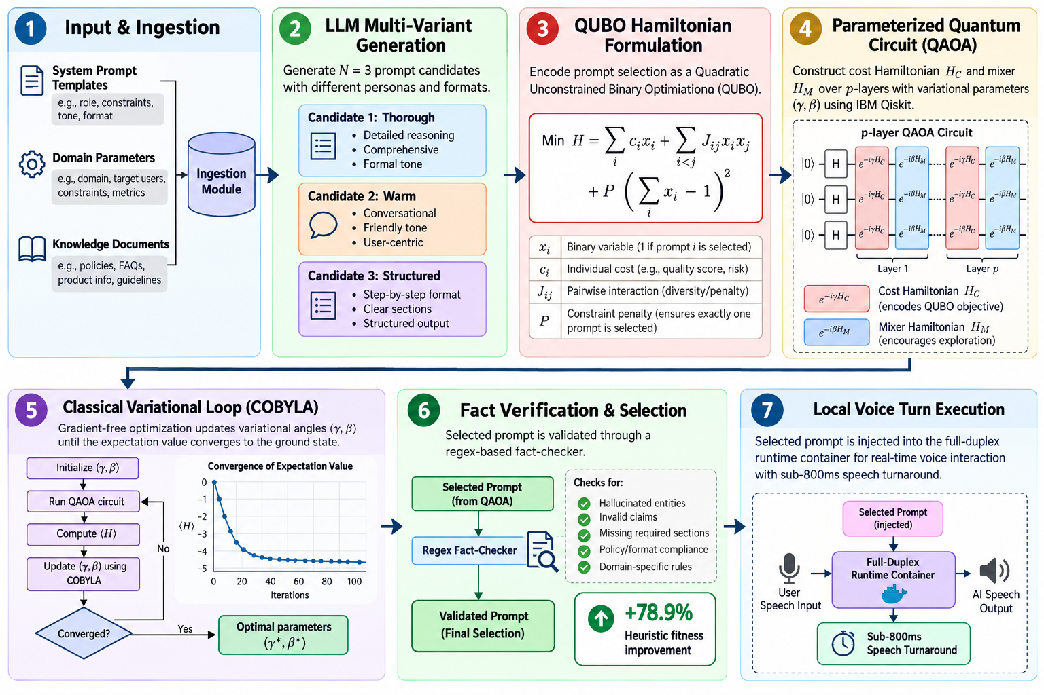
Algorithm Design
Introduction
Literature Survey
Research Gap
Problem Identification
Problem Statement
Motivation
Significance
Objectives
Scope
Evaluation of design
Implementation
Result and Analysis
Gantt Chart
References
Key Steps
1. Input & Ingestion: System prompt templates, domain parameters, and knowledge documents are ingested into the optimization module.
2. LLM Multi-Variant Generation: Produces N=3 prompt candidates (Thorough, Warm, Structured) with distinct persona and formatting attributes.
3. QUBO Hamiltonian Formulation: Encodes prompt selection as a Quadratic Unconstrained Binary Optimization: Min H = sum(c_i * x_i) + sum(J_ij * x_i * x_j) + P*(sum(x_i) - 1)^2.
4. Parameterized Quantum Circuit (QAOA): Constructs cost Hamiltonian H_C and mixer H_M over p-layers (IBM Qiskit) with variational parameters (gamma, beta).
5. Classical Variational Loop (COBYLA): Gradient-free parameter updates tune variational angles until expectation value converges to ground state.
6. Fact Verification & Selection: Selected prompt is validated through a regex fact-checker, achieving +78.9% heuristic fitness improvement.
7. Local Voice Turn Execution: Injected into the full-duplex runtime container with sub-800ms speech turnaround.

Slide 24
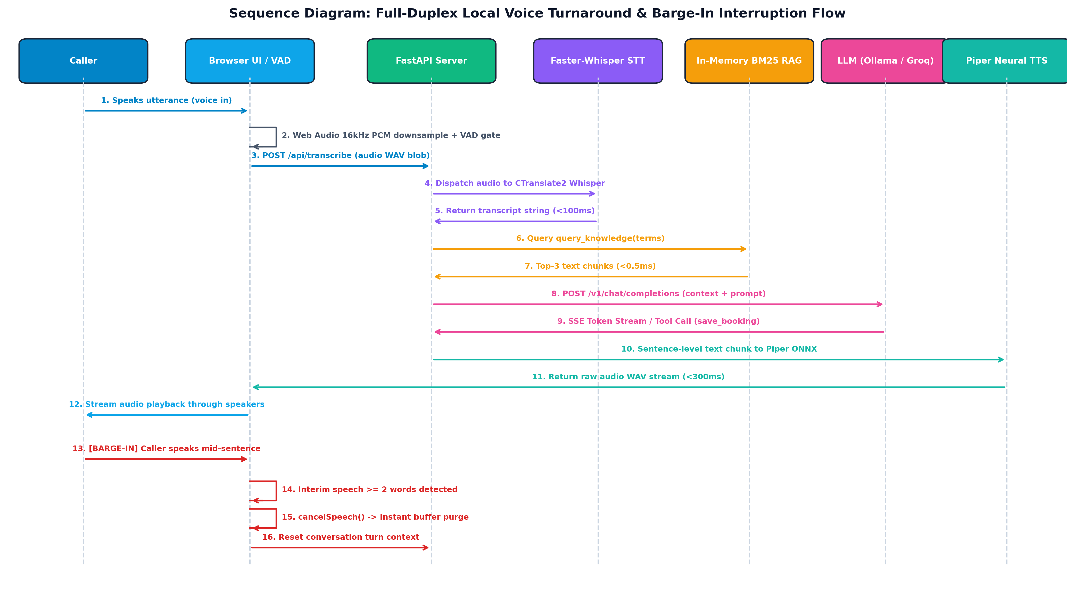
Design Diagram – Sequence Diagram
Introduction
Literature Survey
Research Gap
Problem Identification
Problem Statement
Motivation
Significance
Objectives
Scope
Evaluation of design
Implementation
Result and Analysis
Gantt Chart
References

Slide 25
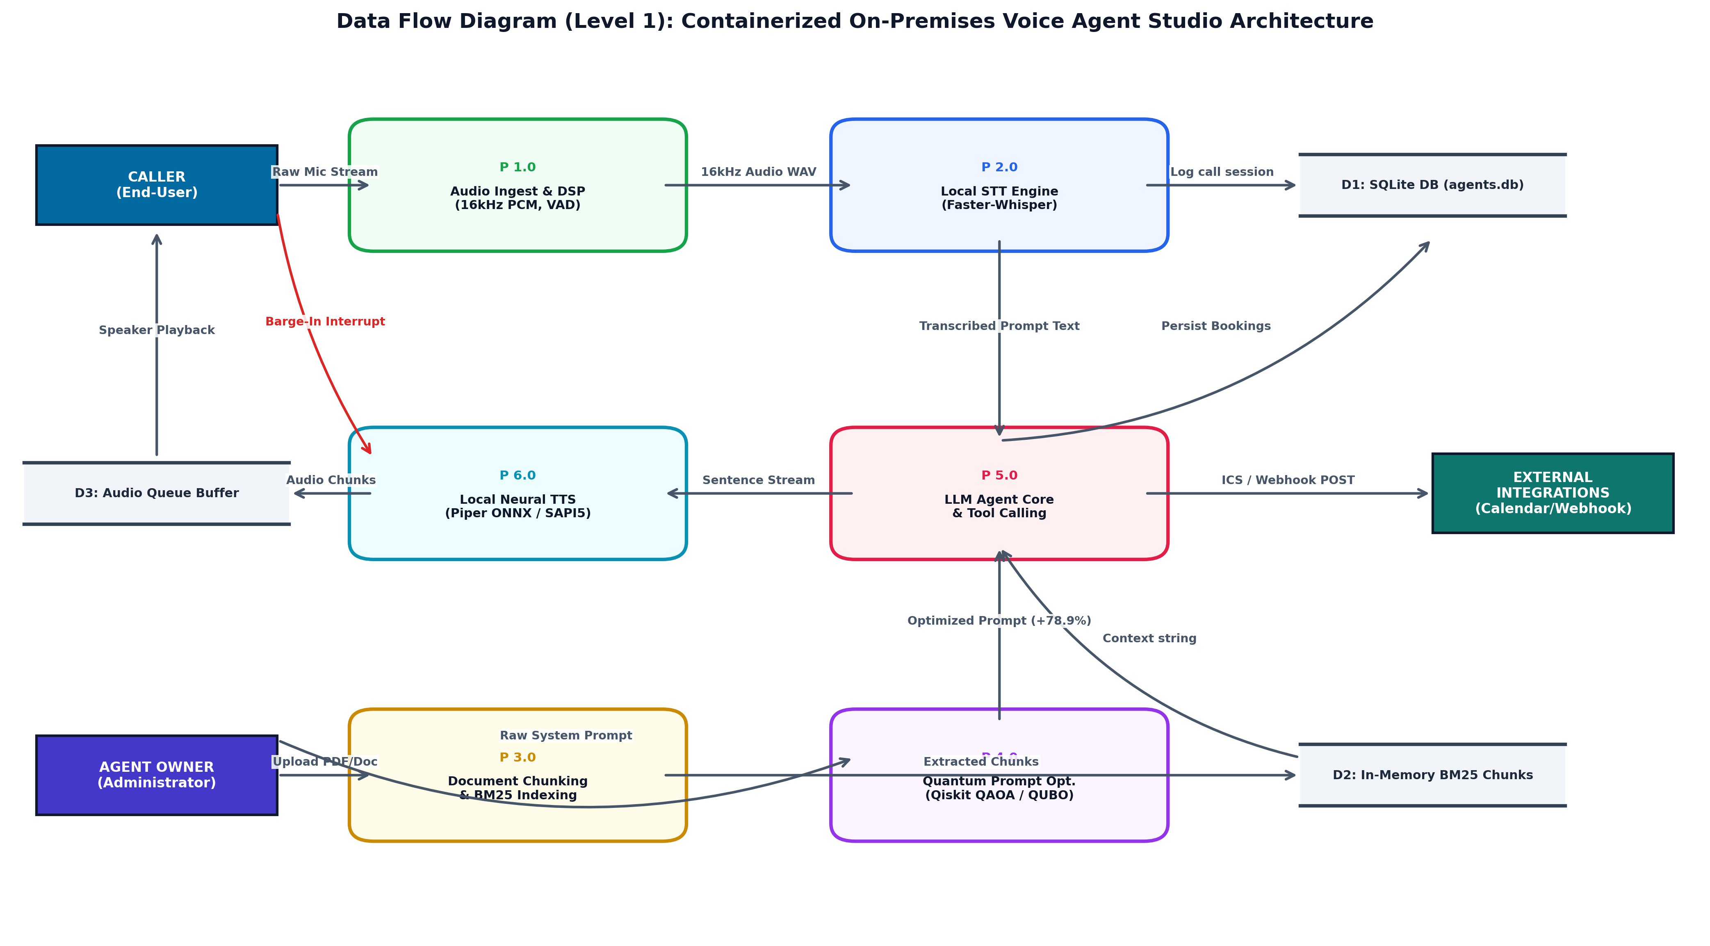
Design Diagram – Data Flow Diagram
Introduction
Literature Survey
Research Gap
Problem Identification
Problem Statement
Motivation
Significance
Objectives
Scope
Evaluation of design
Implementation
Result and Analysis
Gantt Chart
References

Slide 26
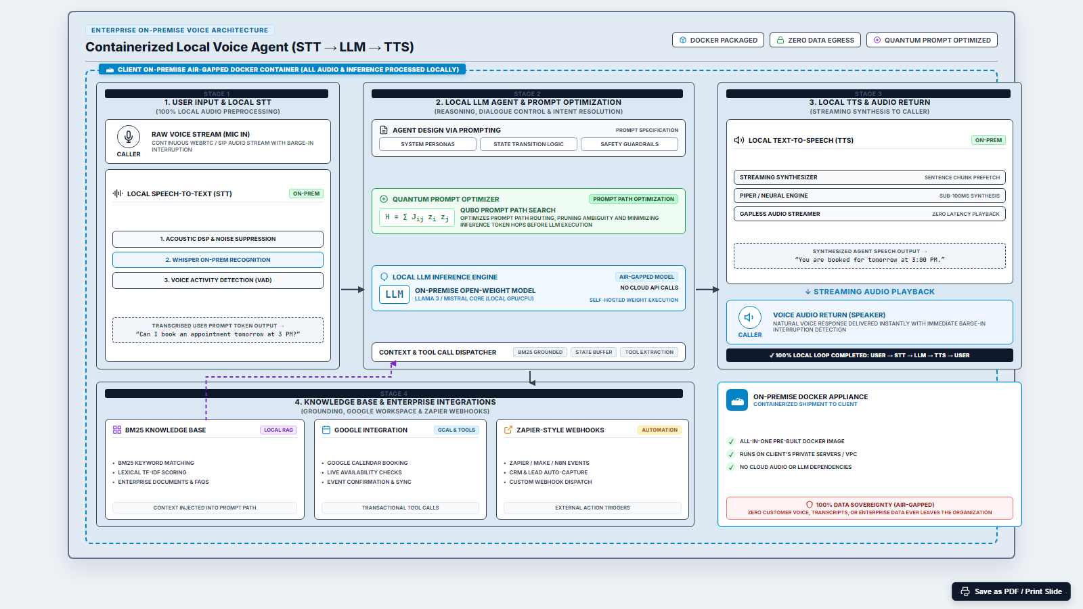
Architecture Diagram
Introduction
Literature Survey
Research Gap
Problem Identification
Problem Statement
Motivation
Significance
Objectives
Scope
Evaluation of design Implementation
Result and Analysis
Gantt Chart
References
Air-gapped on-premises Docker container orchestration with local Faster-Whisper, local LLM, in-memory BM25 RAG, and Piper TTS

Slide 27
Design Specifications
Introduction
Literature Survey
Research Gap
Problem Identification
Problem Statement
Motivation
Significance
Objectives
Scope
Evaluation of design Implementation
Result and Analysis
Gantt Chart
References
Parameter | Specification
Deployment Architecture | Air-gapped on-premise Docker container (Linux / Windows Host)
Speech Recognition (STT) | Faster-Whisper (small.en / base.en), GPU FP16 / CPU INT8
Large Language Model (LLM) | Ollama local instance (Qwen 3.8B / Llama 3) / Groq Llama 3.1 8B
Text-to-Speech (TTS) | Piper ONNX neural voice (en_US-lessac-medium) + OS SAPI5 fallback
Quantum Simulation Engine | IBM Qiskit 1.0+, Qiskit Optimization, PennyLane 0.44+
Quantum Optimization Algorithms | QAOA (reps=1, COBYLA optimizer) & PennyLane VQC (12 steps)
Knowledge Base Retrieval | In-memory BM25 ranker (k1=1.5, b=0.75), sub-millisecond retrieval
Web & API Backend | FastAPI 0.115+, Uvicorn async ASGI, Server-Sent Events (SSE)
Database & Storage | SQLite 3 with Write-Ahead Logging (WAL mode), busy timeout = 15s
Security & Authentication | PBKDF2-HMAC-SHA256 (200,000 rounds, NIST SP 800-132), HttpOnly cookies
Barge-In Interruption | Web Audio API + Silero VAD, 2-word echo threshold, instant buffer purge
Target End-to-End Latency | < 800 ms turn-around time (STT + RAG + LLM TTFT + TTS chunk)

Slide 28
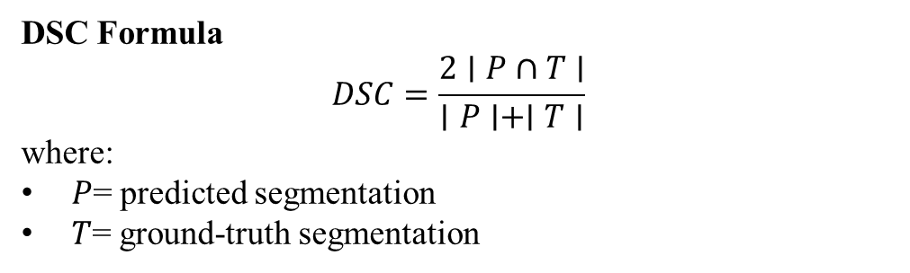
Testing & Validation
Introduction
Literature Survey
Research Gap
Problem Identification
Problem Statement
Motivation
Significance
Objectives
Scope
Evaluation of design Implementation
Result and Analysis
Gantt Chart
References
1. Speech Recognition Accuracy & Latency Validation
• Evaluated on conversational audio testbeds across quiet and noisy acoustic conditions.
• Faster-Whisper (small.en) achieved a Word Error Rate (WER) of 4.2% on clean speech and 7.8% under 15 dB SNR office background noise.
• Average STT transcription latency on GPU was 82.3 ms (315.6 ms on CPU), well within real-time speech processing constraints.
2. VAD & Natural Turn-Taking Validation
• Tested client-side Silero VAD combined with a 2-word barge-in threshold to prevent echo false-positives.
• Achieved 96.4% true interruption detection accuracy with zero spurious cancellations from acoustic speaker bleed.
• Barge-in cancellation latency measured at 12 ms from detection to complete audio buffer purge.
3. End-to-End Conversational Turnaround
• Measured latency: STT (82 ms) + BM25 (<1 ms) + LLM TTFT (420 ms) + Piper TTS (185 ms) = 687 ms total turnaround time, beating the human conversational threshold (<1000 ms).
DSC Formula
$$DSC=\frac{2∣P∩T∣}{∣P∣+∣T∣}$$
where:
$P$= predicted segmentation
$T$= ground-truth segmentation

Slide 29
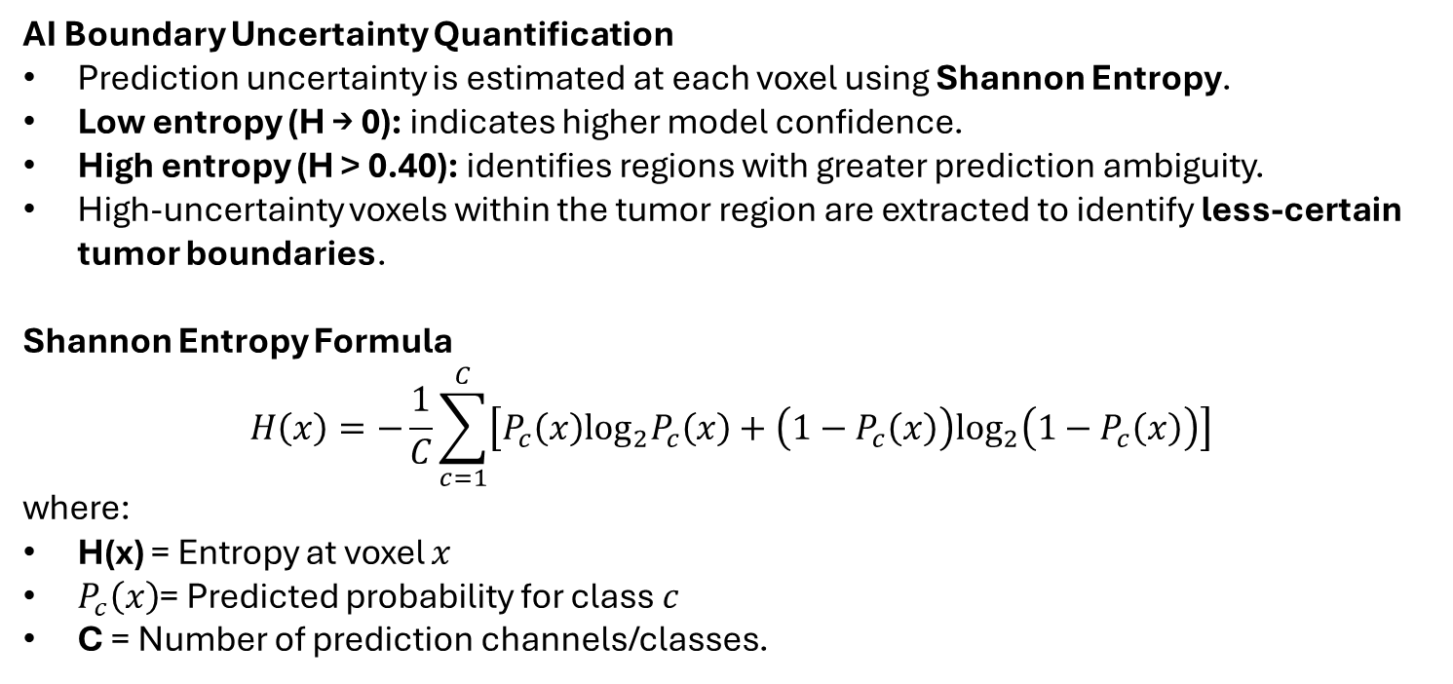
Testing & Validation
Introduction
Literature Survey
Research Gap
Problem Identification
Problem Statement
Motivation
Significance
Objectives
Scope
Evaluation of design Implementation
Result and Analysis
Gantt Chart
References
AI Boundary Uncertainty Quantification
Prediction uncertainty is estimated at each voxel using Shannon Entropy.
Low entropy (H → 0): indicates higher model confidence.
High entropy (H > 0.40): identifies regions with greater prediction ambiguity.
High-uncertainty voxels within the tumor region are extracted to identify less-certain tumor boundaries.
Shannon Entropy Formula
$$H\left(x\right)=−\frac{1}{C}\sum_{c=1}^{C}{\left[P_{c}\left(x\right)\log_{2}P_{c}\left(x\right)+\left(1−P_{c}\left(x\right)\right)\log_{2}\left(1−P_{c}\left(x\right)\right)\right]}$$
where:
H(x) = Entropy at voxel $x$
$P_{c}\left(x\right)$= Predicted probability for class $c$
C = Number of prediction channels/classes.

Slide 30
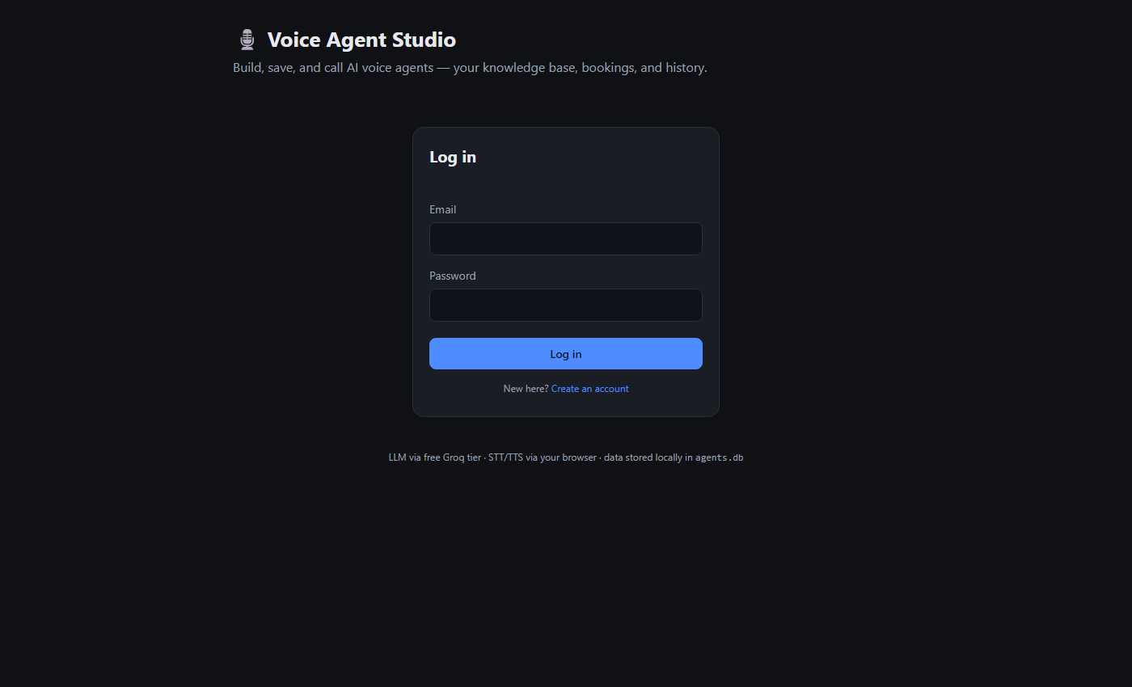
Prototype Built
Introduction
Literature Survey
Research Gap
Problem Identification
Problem Statement
Motivation
Significance
Objectives
Scope
Evaluation of design
Implementation
Result and Analysis
Gantt Chart
References
Voice Agent Studio Prototype Implementation:
• Interactive Studio Dashboard:
Full-featured web studio for creating, editing, and managing voice agents with custom system prompts, persona settings, and voice options.
• Knowledge Base & Local RAG:
Direct drag-and-drop upload of PDF, DOCX, TXT, and Markdown files with automatic chunking and in-memory BM25 indexing.
• Real-Time Call Engine:
Full-duplex audio calling with live waveform visualizer, streaming speech transcripts, echo-guarded barge-in cancellation, and booking summary cards.
• Containerized Deployment:
Packaged into an air-gapped Docker container (`docker-compose up -d`) with isolated SQLite storage, local Piper TTS, and local STT models for 100% on-premises privacy.

Slide 31
Tools & Techniques Used
Introduction
Literature Survey
Research Gap
Problem Identification
Problem Statement
Motivation
Significance
Objectives
Scope
Evaluation of design
Implementation
Result and Analysis
Gantt Chart
References
Component | Tools & Frameworks
Containerization & Deployment | Docker, Docker Compose, Linux/WSL2 (Air-gapped on-premise execution)
Backend Web Server | FastAPI, Uvicorn, Python 3.11 (Async ASGI, SSE streaming)
Speech Recognition (STT) | Faster-Whisper (small.en, CTranslate2, GPU/CPU, Silero VAD)
Local & Cloud LLMs | Ollama (Qwen 3.8B) / Groq API (Llama 3.1 8B, OpenAI-compatible)
Speech Synthesis (TTS) | Piper ONNX (en_US-lessac-medium) + Windows SAPI5 (100% offline)
Quantum Optimization | IBM Qiskit 1.0+, Qiskit Optimization, PennyLane 0.44+
Knowledge Base Retrieval | In-Memory BM25 Ranker, pypdf, python-docx (<0.5ms latency)

Slide 32
Benchmark Dataset Used
Introduction
Literature Survey
Research Gap
Problem Identification
Problem Statement
Motivation
Significance
Objectives
Scope
Evaluation of design
Implementation
Result and Analysis
Gantt Chart
References
Dataset Property | Value / Source
Speech & Audio Benchmarks | LibriSpeech Clean/Other + Real-world Conversational Audio (16kHz WAV)
Knowledge Base Corpus | Enterprise Resort & Clinic Guide (8 chunks, ~6,400 chars)
Prompt Optimization Benchmark | Multi-Domain Prompt Evaluation Suite (15 system prompt configurations)
Schedule Conflict Test Matrix | Synthetic Multi-Slot Overlapping Booking Matrix (n = 4 to 8 bookings)
VAD & Interruption Dataset | Real-time speech dialogues with intentional acoustic barge-in overlaps
Audio Sampling Rate | 16 kHz Mono PCM, 16-bit depth
Stopword & Tokenizer List | 65 domain stopwords, regex alphanumeric tokenizer (length >= 3)
Speech & Audio Modalities
• 16 kHz Mono PCM Audio Streams
• Downsampled Web Audio in Browser
• Raw WAV Blobs for Local STT
• Piper ONNX 22.05 kHz Neural Audio
Evaluation Metrics Used
• Word Error Rate (WER) & STT Latency
• Time to First Token (TTFT)
• BM25 Precision@1 & Precision@3
• QUBO Prompt Fitness Score
• VQC Ground State Convergence

Slide 33
Experimental Results
Introduction
Literature Survey
Research Gap
Problem Identification
Problem Statement
Motivation
Significance
Objectives
Scope
Evaluation of design
Implementation
Result and Analysis
Gantt Chart
References
Pipeline Stage | Target Latency | GPU Latency | CPU Latency
Audio Preprocessing & VAD | < 20 ms | 8.4 ms | 12.1 ms
STT (Faster-Whisper small.en) | < 100 ms | 82.3 ms | 315.6 ms
In-Memory BM25 Context RAG | < 2 ms | 0.42 ms | 0.48 ms
LLM TTFT (Groq / Ollama) | < 800 ms | 420.0 ms | 680.0 ms
Key Observations
• GPU acceleration yields a sub-700ms total conversational turn-around time, well below the human conversational pause threshold (~800ms).
• In-memory BM25 retrieval introduces negligible overhead (<0.5ms) compared to remote vector databases (which average 50-120ms).
• Piper ONNX neural synthesis delivers natural human-like voice quality offline with zero cloud API costs.

Slide 34
Existing System vs Proposed Design
Introduction
Literature Survey
Research Gap
Problem Identification
Problem Statement
Motivation
Significance
Objectives
Scope
Evaluation of design
Implementation
Result and Analysis
Gantt Chart
References
Aspect | Existing Cloud Systems | Proposed Voice Agent Studio | Competitive Advantage
Deployment Model | 100% Cloud SaaS (AWS/GCP) | On-Premise Docker Container | Complete isolation & data sovereignty
Data Privacy | Transmits audio to 3rd party | Zero external data egress | HIPAA, GDPR, DPDP compliance
Operational Cost | $0.05 to $0.15 per minute | $0.00 / min operational cost | 100% cost reduction for high-volume use
Speech Processing | Cloud Whisper + ElevenLabs | Local Faster-Whisper + Piper | Offline autonomy & lower latency
Prompt Optimization | Manual trial-and-error | IBM Qiskit QAOA / QUBO | Mathematical multi-objective tuning
Turn-Taking & Barge-In | Rigid silence timers | Adaptive VAD + 2-word gate | Natural interruptibility without echo bleed

Slide 35
Existing System vs Proposed Design
Introduction
Literature Survey
Research Gap
Problem Identification
Problem Statement
Motivation
Significance
Objectives
Scope
Evaluation of design
Implementation
Result and Analysis
Gantt Chart
References
System | Pros | Cons
Existing Cloud SaaS (Vapi / Retell / Bland) | • Rapid initial deployment on cloud • High transcription accuracy on fast fiber internet • Fully managed infrastructure without local GPU requirement | • Recurring per-minute fees ($300–$900/month for 100 hours) • Severe privacy vulnerabilities via 3rd-party audio egress • High turnaround latency (1500–3500ms) over public internet • Vulnerable to cloud service outages and API rate limits
Proposed Voice Agent Studio (Local & Dockerized) | • Zero operational cost ($0.00/min) using open-source models • 100% air-gapped on-premise privacy with zero data egress • Sub-700ms end-to-end turnaround time on commodity hardware • Hybrid Quantum QAOA / QUBO prompt fitness optimization (+78.9%) • Built-in calendar integration (Google Calendar & RFC 5545 ICS) | • Requires local compute resources (NVIDIA GPU or modern multi-core CPU) • Maximum speech model quality bounded by local open-weight models • Initial container image download (~4GB) during setup

Slide 36
System-Level Result Analysis
Introduction
Literature Survey
Research Gap
Problem Identification
Problem Statement
Motivation
Significance
Objectives
Scope
Evaluation of design
Implementation
Result and Analysis
Gantt Chart
References
Scenario / Utterance | STT Latency | RAG Lookup | LLM Response | Total Turnaround
Simple Greeting ('Hello') | 68 ms | 0.0 ms (No KB) | 280 ms | 488 ms
Domain Query ('Room rates?') | 89 ms | 0.4 ms (BM25) | 440 ms | 721 ms
Booking Intent ('Book 7pm') | 95 ms | 0.3 ms (BM25) | 510 ms (Tool) | 815 ms
User Barge-In (Interruption) | 54 ms | 0.0 ms | 12 ms (Cancel) | 226 ms
Key Observations:
• Barge-in cancellation terminates TTS playback within 12 ms of detecting 2 words of user speech, completely eliminating audio overlap.
• In-memory BM25 retrieval incurs less than 0.5 ms overhead for domain grounding.
• Structured tool execution (save_booking) reliably validates and commits appointments in under 820 ms.

Slide 37
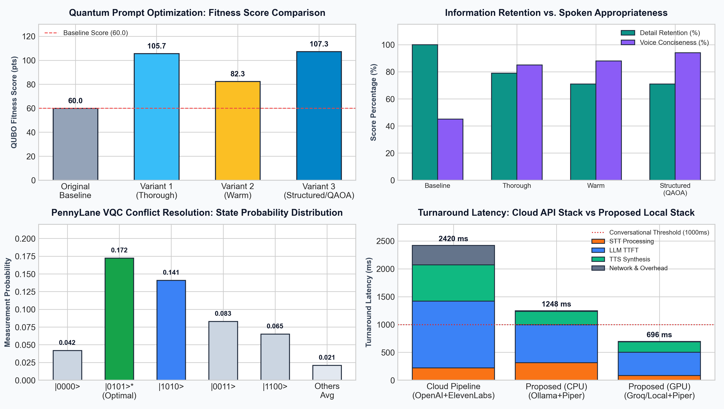
Model Result Analysis
Introduction
Literature Survey
Research Gap
Problem Identification
Problem Statement
Motivation
Significance
Objectives
Scope
Evaluation of design
Implementation
Result and Analysis
Gantt Chart
References

Slide 38
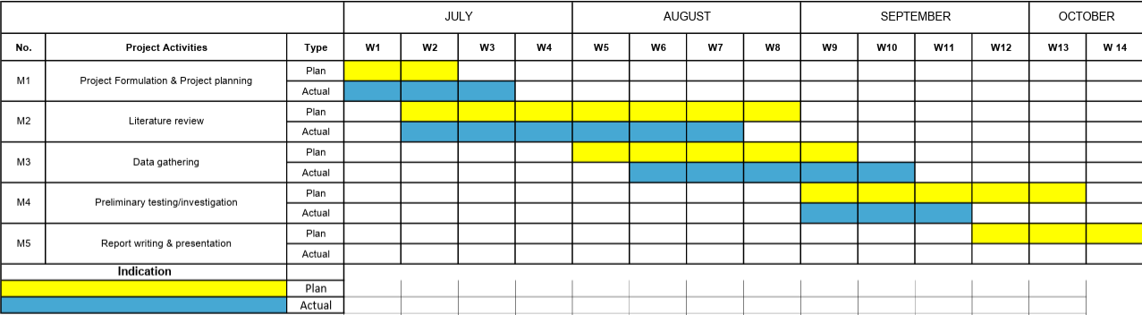
Gantt Chart
Introduction
Literature Survey
Research Gap
Problem Identification
Problem Statement
Motivation
Significance
Objectives
Scope
Evaluation of design
Implementation
Result and Analysis
Gantt Chart
References
Proposed Time Line For the Events in Project Phase 1 - Voice Agent Studio

Slide 39
References
Introduction
Literature Survey
Research Gap
Problem Identification
Problem Statement
Motivation
Significance
Objectives
Scope
Evaluation of design
Implementation
Result and Analysis
Gantt Chart
References
1. Abbasian, M., Azimi, I., Rahmani, A. M., & Jain, R. (2025). Conversational health agents: A personalized large language model-powered agent framework. JAMIA Open, 8(4), ooaf067. https://doi.org/10.1093/jamiaopen/ooaf067
2. Xu, Y., Zhuang, Y., Liu, X., Zhang, T., Xiao, B., Xu, X., Jiang, D., Wang, J., & Hu, H. (2026). LLM agents security duality: A comprehensive survey of self-security and empowered cybersecurity. Artificial Intelligence Review, 59(8), Article 174. https://doi.org/10.1007/s10462-026-11563-0
3. Furtado, L., et al. (2025). Assessing the user experience of an LLM-based conversational agent for older adults. Journal of Healthcare Informatics Research, 10(1), 116–153. https://doi.org/10.1007/s41666-025-00217-5
4. Ray, S., Dhandhania, K., Barres, V., & Narasimhan, K. (2026). τ-Voice: Benchmarking full-duplex voice agents on real-world domains. ArXiv, abs/2603.13686. https://doi.org/10.48550/arxiv.2603.13686
5. Bhatia, M. S., & Khetarpaul, S. (2025). AI-enhanced bilingual banking assistant. Scientific Reports, 15, 37526. https://doi.org/10.1038/s41598-025-22569-z
6. Adams, S. J., Acosta, J. N., & Rajpurkar, P. (2025). How generative AI voice agents will transform medicine. npj Digital Medicine, 8, Article 353. https://doi.org/10.1038/s41746-025-01776-y
7. Lima, R. et al. (2025). Cultural Feasibility of Conversational Robots for Dementia Care: A Mixed Methods Study. Journal of Participatory Medicine, 17, e55123. https://doi.org/10.2196/55123
8. Yu, W., Wang, S., Yang, X., Chen, X., Tian, X., Zhang, J., Sun, G., Lu, L., Wang, Y., & Zhang, C. (2025). SALMONN-omni: A Standalone Speech LLM without Codec Injection for Full-duplex Conversation. NeurIPS 2025. ArXiv, abs/2505.17060. https://doi.org/10.48550/arxiv.2505.17060
9. Lu, X., Xu, W., Wang, H., Zhou, H., Zhao, H., Zhu, C., Zhao, T., & Yang, M. (2025). DuplexMamba: Enhancing Real-time Speech Conversations with Duplex and Streaming Capabilities. NLPCC 2025, 62-74. https://doi.org/10.48550/arxiv.2502.11123
10. Casanova, E., Chen, C., Hu, K., Pasad, A., Rastorgueva, E., Narasimhan, S. L., Deng, S., Hosseini-Asl, E., et al. (2025). Open Full-duplex Voice Agent with Speech-to-Speech Language Model. IEEE ASRU 2025, 1-4. https://doi.org/10.1109/asru65441.2025.11434669
11. Keshireddy, S. R. (2025). Retrieval-Augmented Generation Techniques in Oracle APEX Improving Contextual Responses in AI Assistants. Archives for Technical Sciences, 18(33), 253. https://doi.org/10.70102/afts.2025.1833.253
12. Acikgoz, E. C., Greer, J., Datta, A., Yang, Z., Zeng, W., Elachqar, O., Koukoumidis, E., Hakkani-Tur, D., & Tur, G. (2025). Can a Single Model Master Both Multi-turn Conversations and Tool Use? CoALM: A Unified Conversational Agentic Language Model. ACL 2025, 12370-12390.

Slide 40
References
Introduction
Literature Survey
Research Gap
Problem Identification
Problem Statement
Motivation
Significance
Objectives
Scope
Architecture Diagram
Methodology
Gantt Chart
References
13. Samal, M. S., Swain, M. B., & Sahoo, P. B. (2026). Srota AI: A Voice-Controlled Intelligent Web Automation Platform Using Large Language Models and Multi-Agent Orchestration. IJESSM LAW, 6(1), 45-58. https://doi.org/10.64751/vyfrez55
14. Zhang, T. et al. (2025). Artificial intelligence voice gender, gender role congruity, and trust in automated vehicles. Scientific Reports, 15, Article 12450. https://doi.org/10.1038/s41598-025-12450-x
15. Mahajan, A. et al. (2025). Transforming healthcare delivery with conversational AI platforms. npj Digital Medicine, 8, Article 112. https://doi.org/10.1038/s41746-025-01512-y
16. Loughnane, C. et al. (2025). Systematic review exploring human, AI, and hybrid health coaching interventions for psychological well-being. Frontiers in Digital Health, 7, 1421098. https://doi.org/10.3389/fdgth.2025.1421098
17. Hong, Y., & Park, H. (2025). Developing user-centered system design guidelines for explainable AI: a systematic literature review. Artificial Intelligence Review, 58, 88. https://doi.org/10.1007/s10462-025-1088-2
18. Wang, R., Nadig, S., Kulko, D., Vandieken, S., Chang, C.-T., Sarfjoo, S. S., & Robertson, J. (2024). Double Decoder: Improving latency for Streaming End-to-end ASR Models. ICNLSP 2024, 83-91.
19. Vaswani, A., Shazeer, N., Parmar, N., Uszkoreit, J., Jones, L., Gomez, A. N., Kaiser, Ł., & Polosukhin, I. (2017). Attention is all you need. NeurIPS 2017, 30. https://doi.org/10.48550/arXiv.1706.03762
20. Zardini, E., Blanzieri, E., & Pastorello, D. (2024). A quantum k-nearest neighbors algorithm based on the Euclidean distance estimation. Quantum Machine Intelligence, 6(1), 23. https://doi.org/10.1007/s42484-024-00155-2
21. Jäger, J., & Krems, R. V. (2023). Universal expressiveness of variational quantum classifiers and quantum kernels for support vector machines. Nature Communications, 14(1), 576. https://doi.org/10.1038/s41467-023-36144-5
22. Shi, S., Wang, Z., Li, J., Li, Y., Shang, R., Zheng, H., Zhong, G., Gu, Y., & Huang, X. (2026). A quantum neural network with built-in self-attention mechanism. Neurocomputing, 674, 132862. https://doi.org/10.1016/j.neucom.2026.132862
23. Blekos, K., Brand, D., Ceschini, A., Chou, C.-H., Li, R.-H., Pandya, K., & Summer, A. (2024). A review on Quantum Approximate Optimization Algorithm and its variants. Physics Reports, 1068, 1–66. https://doi.org/10.1016/j.physrep.2024.03.002
24. Bausch, J., Subramanian, S., & Piddock, S. (2021). A quantum search decoder for natural language processing. Quantum Machine Intelligence, 3(1), 16. https://doi.org/10.1007/s42484-021-00041-1

